Slide 1
Dynamic Multipoint VPN (DMVPN) Overview

Slide 2
In This Section
» Dynamic Multipoint VPN (DMVPN) Overview
• What is DMVPN?
• Why use DMVPN?
• How DMVPN works

Slide 3
What is DMVPN?
» Point-to-multipoint Layer 3 overlay VPN
• Logical hub and spoke topology
• Direct spoke-to-spoke traffic is supported
» DMVPN uses a combination of…
• Multipoint GRE Tunnels (mGRE)
• Next Hop Resolution Protocol (NHRP)
• IPsec Crypto Profiles
• Routing

Slide 4
Why Use DMVPN?
» Independent of SP access method
• Only requirement is IP connectivity
» Routing policy is not dictated by SP
• E.g. MPLS L3VPN restrictions
» Highly scalable
• If properly designed

Slide 5
DMVPN Concepts
» Hub Router
• Reachable via static, public IP address
» Spoke Routers
• Reachable via static, or dynamic, public IP addresses
» Multipoint GRE tunnels
» IPsec (optional, but typically used)

Slide 6
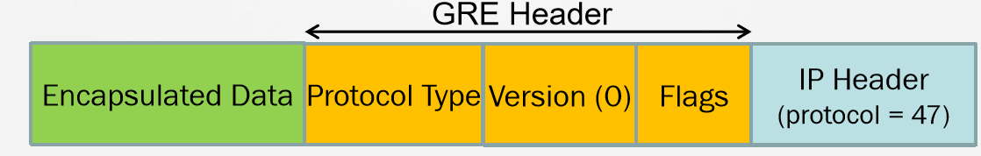
What is GRE?
» GRE = Generic Route Encapsulation
» Defined in RFC 2784
» Tunneling mechanism
• GRE can tunnel many different protocols inside a GRE Header.
» Default encapsulation for Cisco IOS Tunnel Interfaces

Slide 7
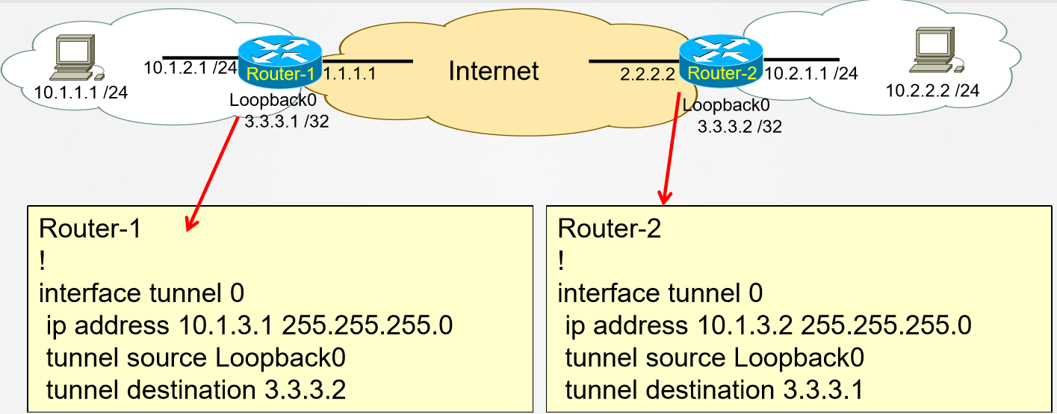
Typical GRE Configuration (P2P)

Slide 8
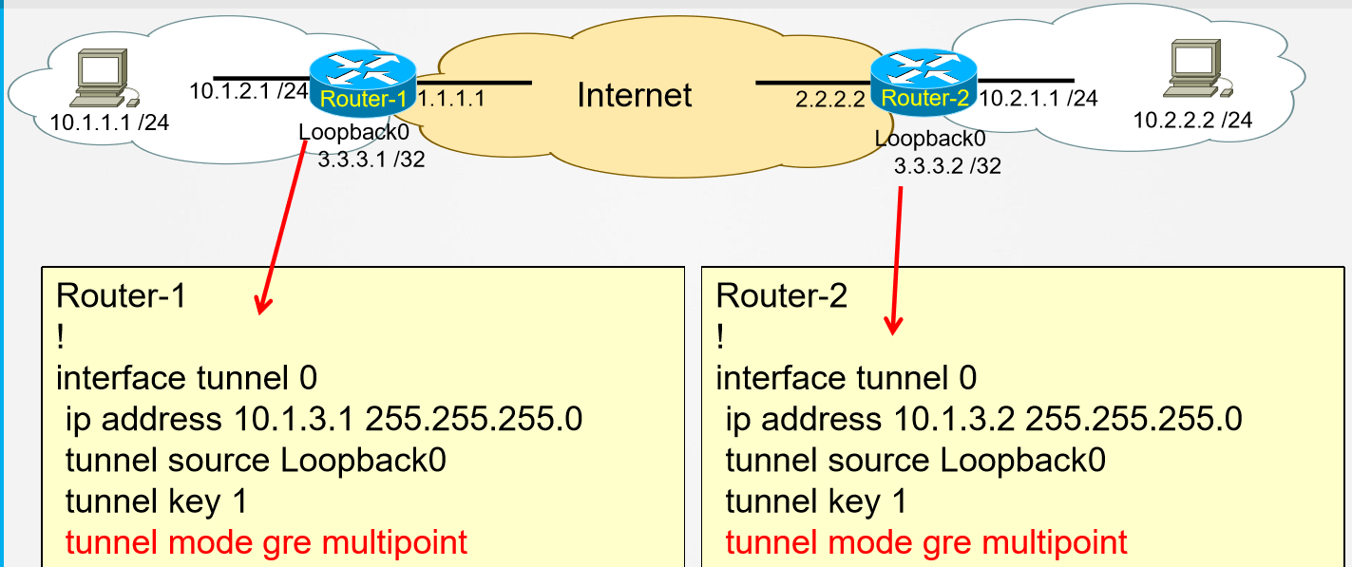
mGRE Configuration

Slide 9
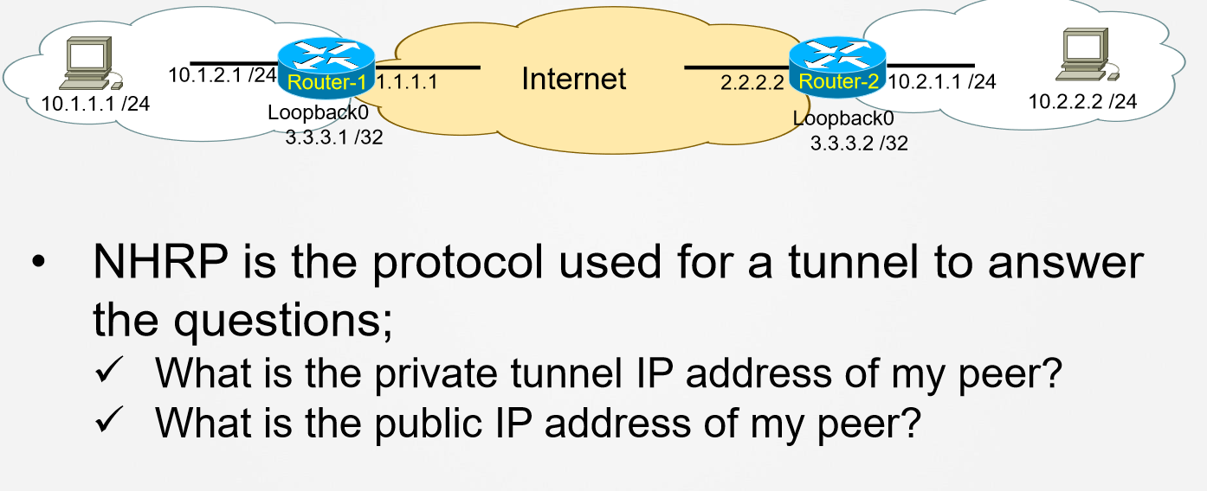
How Do I Find The Tunnel Destination??

Slide 10
What is NHRP?
» Next Hop Resolution Protocol
» Defined in RFC 2332
» Used in DMVPN to map a peer’s tunnel IP address to that peer’s public IP address.
» NHRP can populate the NHRP cache via static or dynamic entries (similar to ARP)What is NHRP?

Slide 11
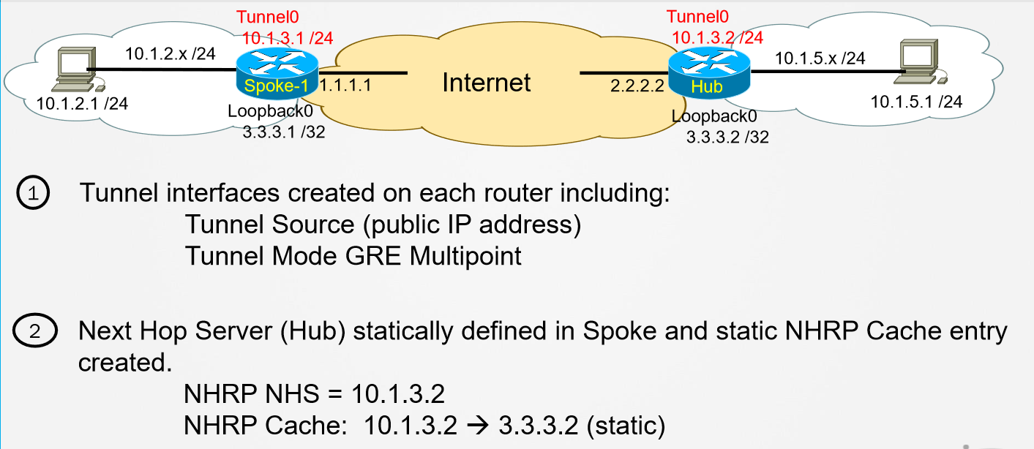
DMVPN – How it works

Slide 12
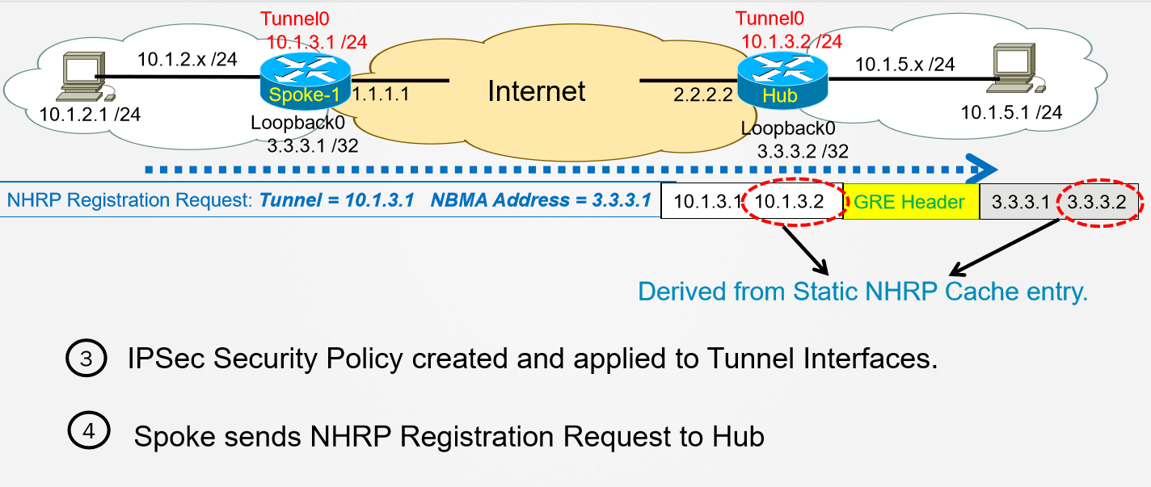

Slide 13
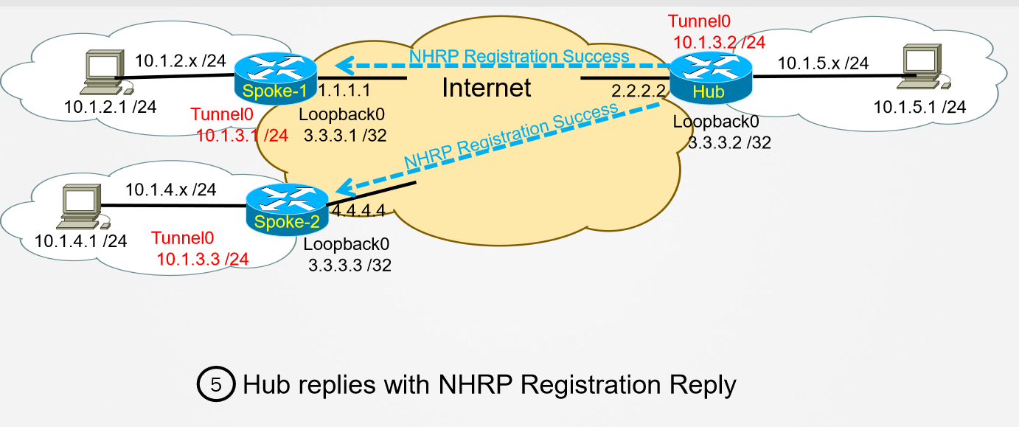

Slide 14
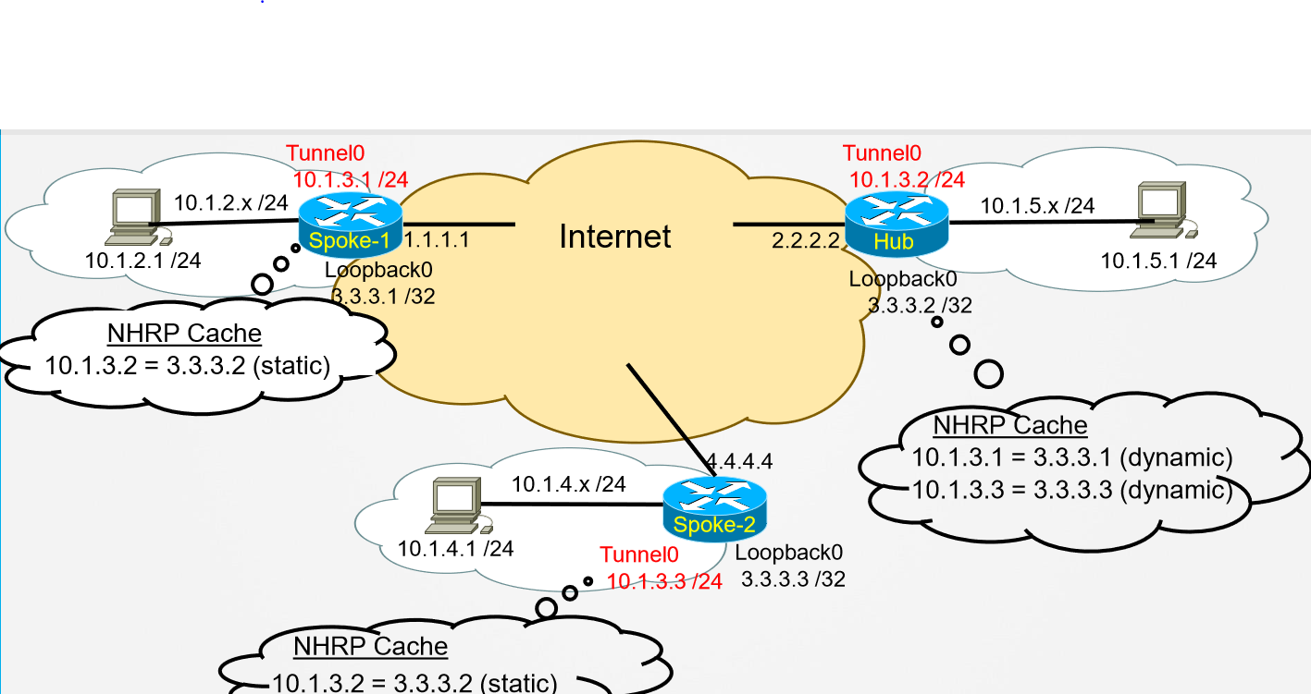

Slide 15
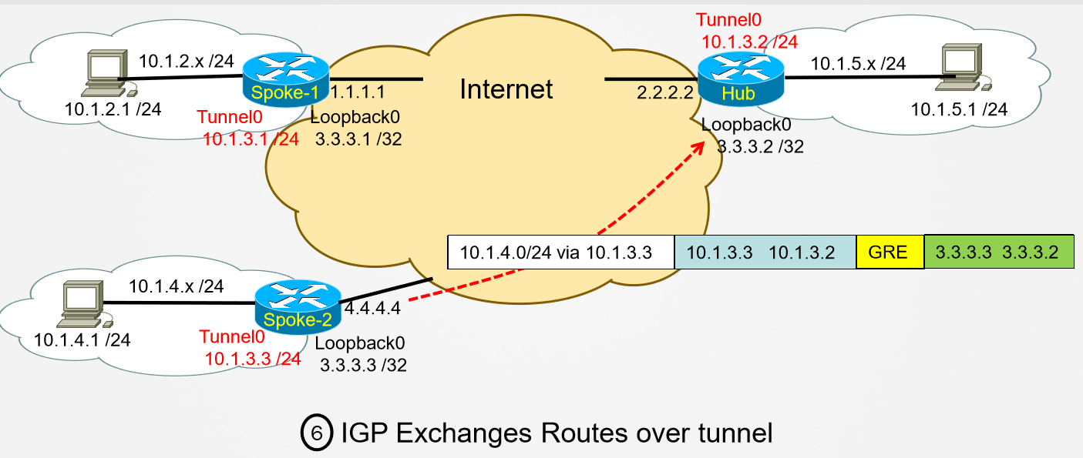

Slide 16
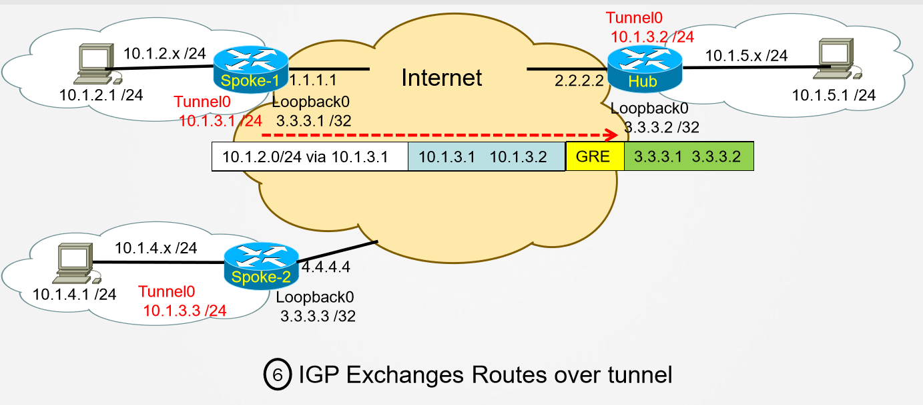

Slide 17
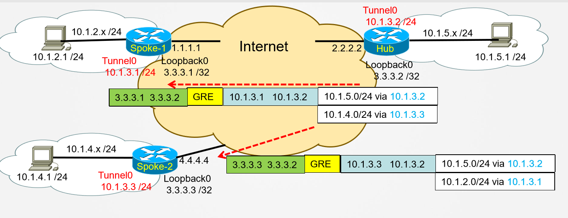

Slide 18
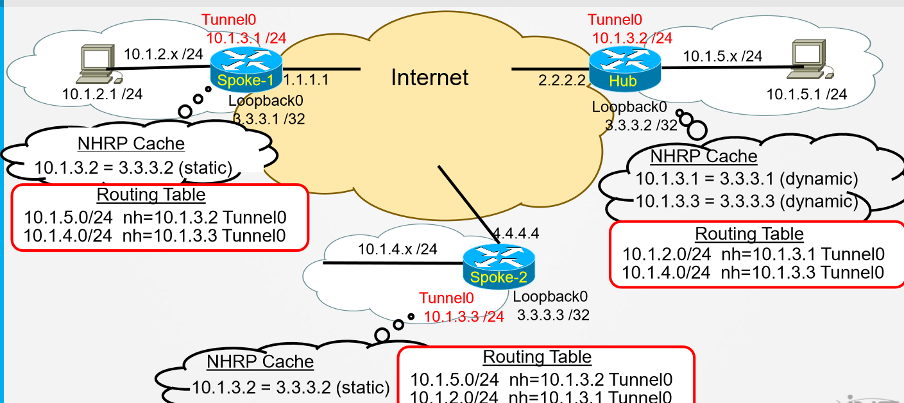

Slide 19
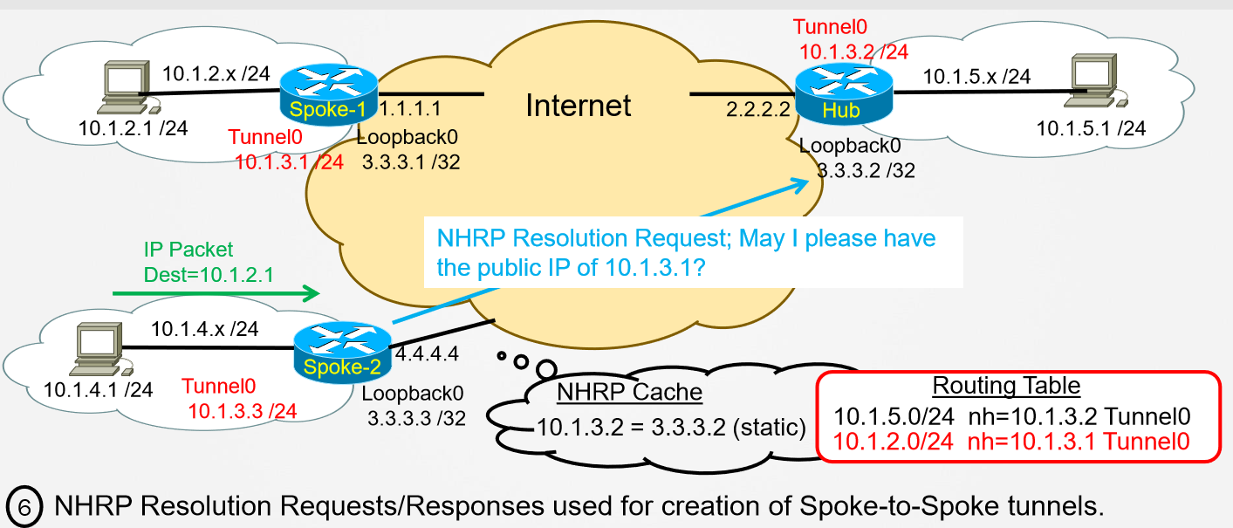

Slide 20
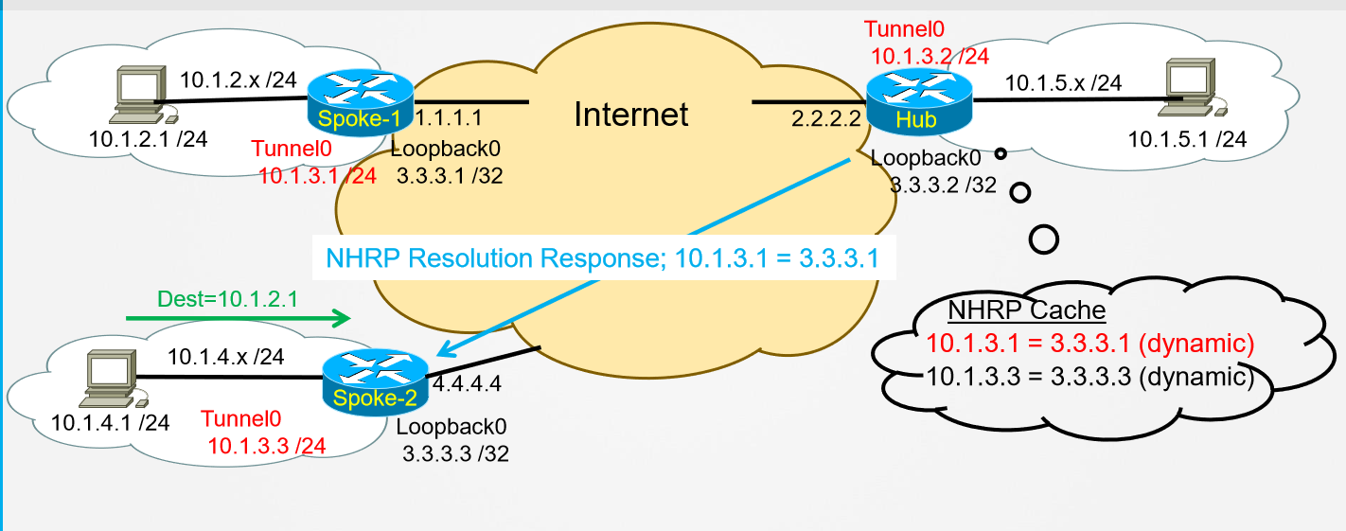

Slide 21
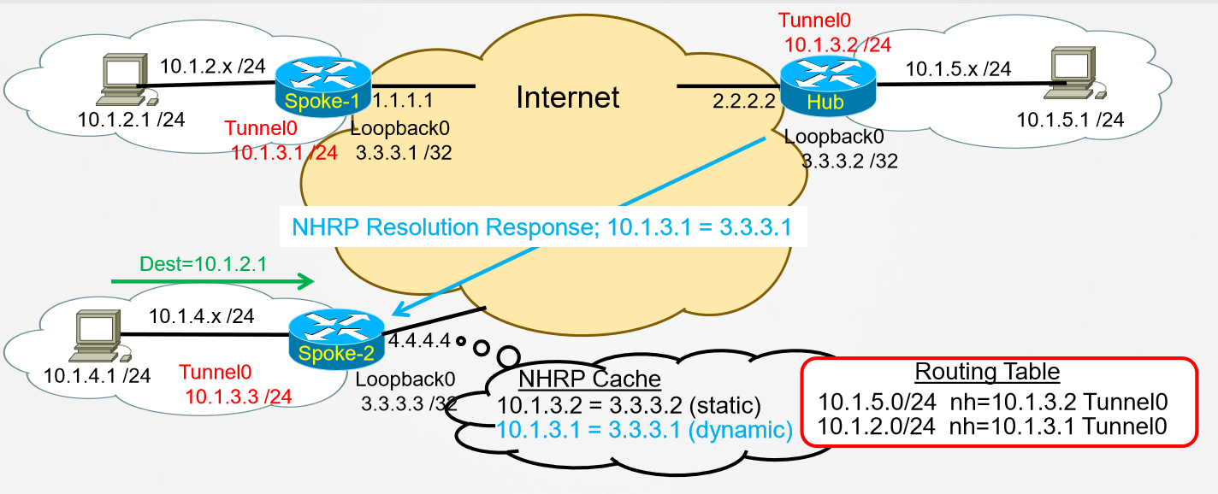

Slide 22
DMVPN Phases
» Phase-1: Hub and Spoke only
» Phase-2: Adds Spoke-to-Spoke Capability
• Previous slides demonstrated Phase-2
• In this phase, all Spoke Routers must know all IP Routes of all other Spoke Routers.
» Phase-3: Modification of Routing Behavior
• Hub allowed to summarize all routes from Spokes
• Sets the next-hop of summarized routes to itself.
• Hub can send NHRP Redirect Message to Spokes.

Slide 23
DMVPN Summary
» Creates on-demand tunnels between nodes
• Initial tunnel-mesh is hub-and-spoke (always on)
• Traffic patterns trigger spoke-to-spoke tunnels
• Solves management scalability problem
» Maintains tunnels based on traffic patterns
• Spoke-to-spoke tunnel is on-demand
• Spoke-to-spoke tunnel lifetime is based on traffic
» Requires two IGPs: Underlying and Overlay
• IPv4/IPv6 supported for both passenger and transport

Slide 24
Summary - NHRP Important Messages
» NHRP Registration Request / Response
• Spokes register their NMBA and VPN IP to NHS
• Required to build the spoke-to-hub tunnels
» NHRP Resolution Request / Response
• Spoke queries for the NBMA-to-VPN mappings of other spokes
• Required to build spoke-to-spoke tunnels
» NHRP Redirect
• NHS answer to a spoke-to-spoke data-plane packet through it
• Similar to IP redirects, when packet in/out interface is the same
• Used only in DMVPN Phase3 to build spoke-to-spoke tunnels

